Slide 1
JPA
Java Persistence consists of four areas:
The Java Persistence API
The query language
The Java Per sistence Criteria API
Object/relational mapping metadata

Slide 2
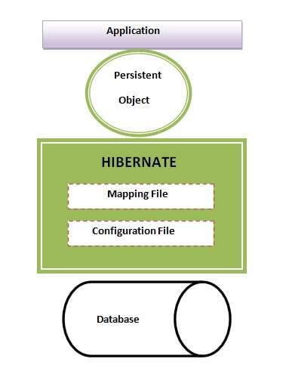
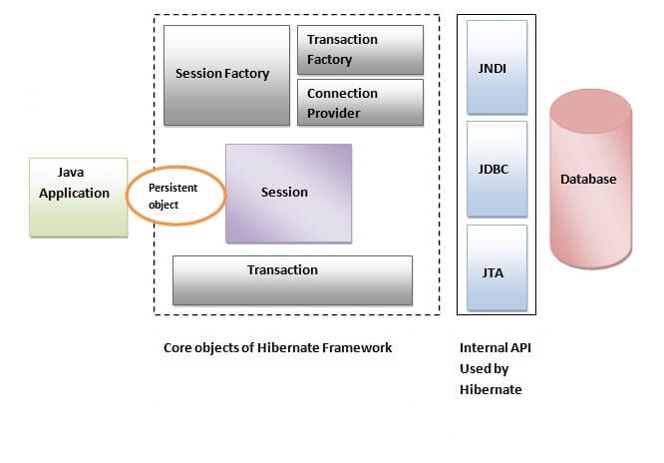
Hibernate Architecture

Slide 3
Hibernate Architecture
Hibernate framework uses many objects such as session factory, session, transaction etc. alongwith existing Java API such as JDBC (Java Database Connectivity), JTA (Java Transaction API) and JNDI (Java Naming Directory Interface).
Configuration : Generally written in hibernate.properties or hibernate.cfg.xml files. For Java configuration, you may find class annotated with @Configuration. It is used by Session Factory to work with Java Application and the Database. It represents an entire set of mappings of an application Java Types to an SQL database.
Session Factory : Any user application requests Session Factory for a session object. Session Factory uses configuration information from above listed files, to instantiates the session object appropriately.
Session : This represents the interaction between the application and the database at any point of time. This is represented by the org.hibernate.Session class. The instance of a session can be retrieved from the SessionFactory bean.
Query : It allows applications to query the database for one or more stored objects. Hibernate provides different techniques to query database, including NamedQuery and Criteria API.
First-level cache : It represents the default cache used by Hibernate Session object while interacting with the database. It is also called as session cache and caches objects within the current session. All requests from the Session object to the database must pass through the first-level cache or session cache. One must note that the first-level cache is available with the session object until the Session object is live.
Transaction : enables you to achieve data consistency, and rollback incase something goes unexpected.
Persistent objects : These are plain old Java objects (POJOs), which get persisted as one of the rows in the related table in the database by hibernate.They can be configured in configurations files (hibernate.cfg.xml or hibernate.properties) or annotated with @Entity annotation.
Second-level cache : It is used to store objects across sessions. This needs to be explicitly enabled and one would be required to provide the cache provider for a second-level cache. One of the common second-level cache providers is EhCache.

Slide 4
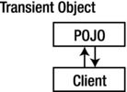
Persistence Life Cycle
Transient Object
Transient objects exist in heap memory. Hibernate does not manage transient objects or persist changes to transient objects.
Transient objects are independent of Hibernate
To persist the changes to a transient object, you would have to ask the session to save the transient object to the database,
at which point Hibernate assigns the object an identifier and marks the object as being in persistent state.

Slide 5
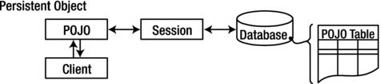
Persistence Life Cycle
Persistent Object
Persistent objects exist in the database, and Hibernate manages the persistence for persistent objects.
Persistent objects are maintained by Hibernate
If fields or properties change on a persistent object, Hibernate will keep the database representation up to date when the application marks the changes as to be committed.

Slide 6
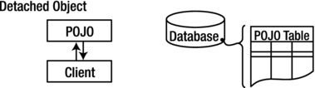
Persistence Life Cycle
Detached Object
Detached objects have a representation in the database, but changes to the object will not be reflected in the database, and vice-versa. This temporary separation of the object and the database is shown in image below.
Detached objects exist in the database but are not maintained by Hibernate
A detached object can be created by closing the session that it was associated with, or by evicting it from the session with a call to the session’s evict() method.

Slide 7
Persistence Life Cycle
Removed Object
Removed objects are objects that are being managed by Hibernate (persistent objects, in other words) that have been passed to the session’s remove() method. When the application marks the changes held in the session as to be committed, the entries in the database that correspond to removed objects are deleted.

Slide 8
Persistence Life Cycle
Summary
Newly created POJO object will be in the transient state. Transient object doesn’t represent any row of the database i.e. not associated with any session object. It’s plain simple java object.
Persistent object represent one row of the database and always associated with some unique hibernate session. Changes to persistent objects are tracked by hibernate and are saved into database when commit call happen.
Detached objects are those who were once persistent in past, and now they are no longer persistent. To persist changes done in detached objects, you must reattach them to hibernate session.
Removed objects are persistent objects that have been passed to the session’s remove() method and soon will be deleted as soon as changes held in the session will be committed to database.

